Slide 1












ENERGY PERFORMANCE CONTRACTING: Practical Examples from Europe
18.10.2016, Jelgava
NIKO NATEK, KSSENA

Slide 2

EPC business model categorization
The EU Joint Research centres exact wording is: »While there are numerous ways to structure a contract […] any attempt to be comprehensive in describing EPC variations is doomed«.
Shared savings:
BOMA Energy Performance Contracting Model (BEPC)
Guaranteed savings:
Public-private partnership DBTO
DBOT - BOOT
DBOO
…
Classical public procurement
Green Energy Performance Contracting
Chauffage model

Slide 3
Starting Position, Motivation of Principal/Company
  In underdeveloped markets, the most effective way is to gain support from experienced partners and start directly with EPC Plus
  Study by Ecofys : „Renovation Tracks for Europe up to 2050: what are the choices“
    Track 1: Shallow renovation, low contribution from renewable energy
    Fast renovation (renovation rate 3%) & average energy efficiency ambition level (~ 32% reduction in energy use for space heating by 2050 compared to 2010), taking into account market failures (e.g. failure to treat the building envelope as a whole), low use of renewable energy.
    Track 2 Shallow renovation and high use of renewable energy
    Renovation rate 2.3% & average energy efficiency ambition level, taking into account market failures (~ 58% reduction in energy use for space heating); limited focus on energy efficiency of the building envelope; advanced systems (high use of renewable energy and heat recovery ventilation).
    Track 3 Deep renovation and high use of renewable energy
    Renovation rate 2.3%, high level of energy efficiency improvement (~80% reduction in energy use for space heating) high focus on energy efficiency of the building envelope; advanced systems (high use of renewable energy and heat recovery ventilation).

Slide 4
Starting Position, Motivation of Principal/Company
  Modelling results: The following table gives an overview of the scenarios and their results for the period 2012 – 2050.
Scenario | Retrofit rate | C02 Emissions for space heating and domestic hot water EU27 by 2050 [Mt] | Final Energy use for space heating EU27 [TWh] by 2050 (without new buildings) | Related reduction in final energy use by 2050 compared to 2010 | Total Costs (investment costs and energy costs for space heating and domestic hot water, discounted costs for period 2012-2050) [trillion EURO]
Track 1 | 3.0% | 498 | 1,987 | 32% | 8.2
Track 2 | 2.3% | 103 | 1,228 | 58% | 8.8
Track 3 | 2.3% | 93 | 613 | 80% | 8.5

Slide 5
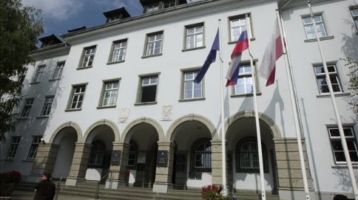


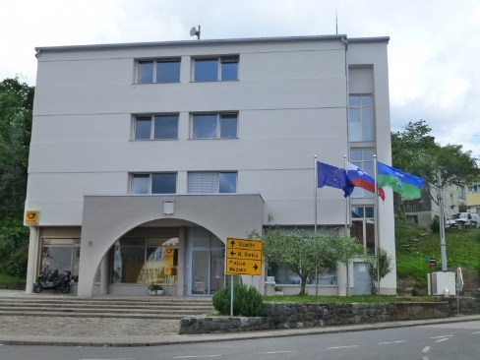

Examples
  Energy performance contracting in the Municipality of Kranj
  Energy performance contracting in the Municipality of Celje
  Refurbishment of the Municipal building in Občina Brda

Slide 6
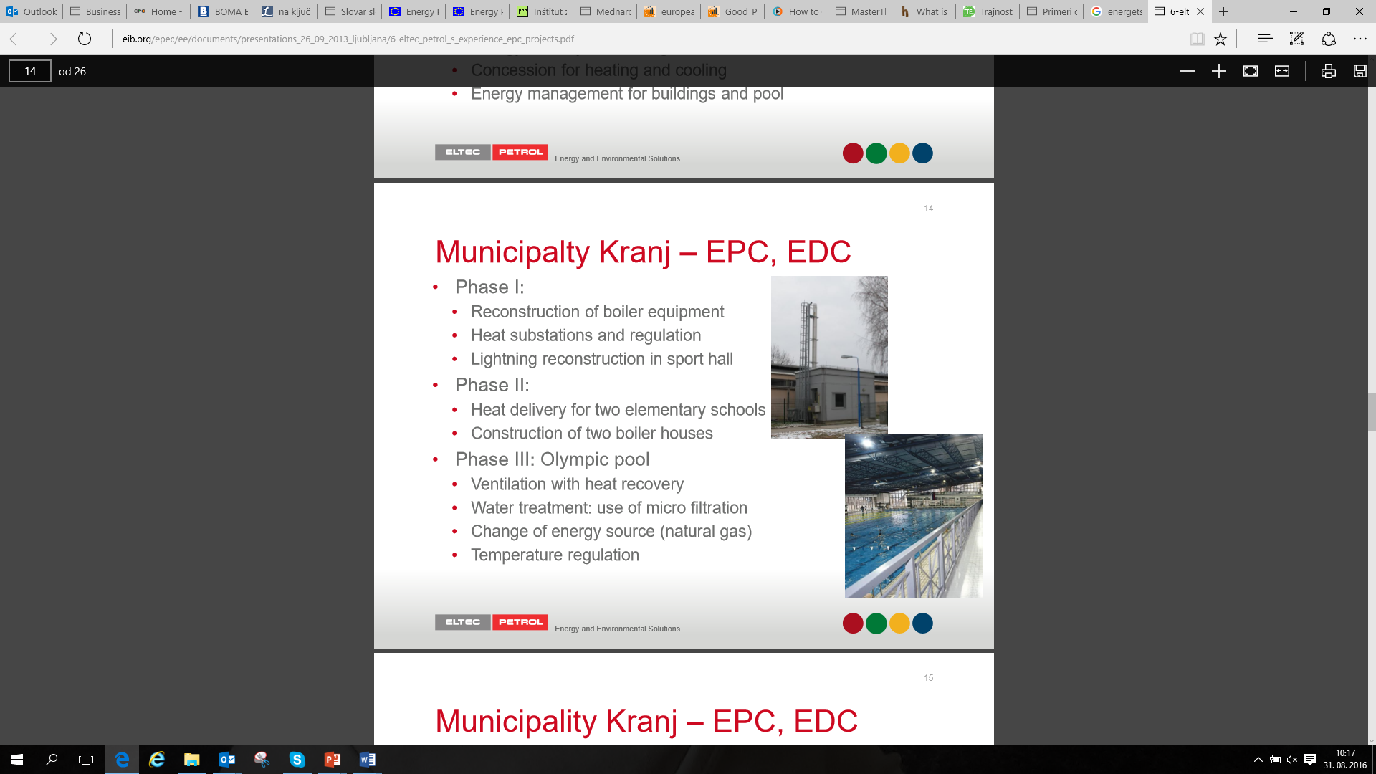
Experience in Slovenia in Slovenia – Municipality of Kranj EPC, ESC
  Begining in 2001, Contract in 2002 – 15 years
  Upgrade in 2007,2008, 2011, 2012
  Measurements are implemented on 16 buildings:
    Office building
    Elementary schools
    Sport halls
    Sport complex with Olympic pool
  Contracts:
    Energy performance contracting
    Energy supply contracting
    Concession for heating and cooling
    Energy management for buildings and pool

Slide 7
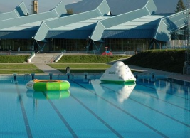
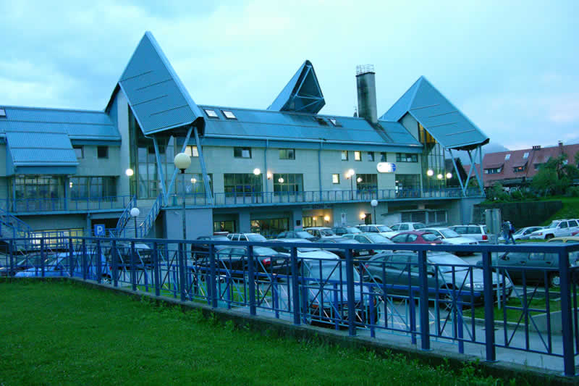
Experience in Slovenia in Slovenia – Municipality of Kranj EPC, ESC
  Phase I:
    Reconstruction of boiler equipment
    Heat substations and regulation
    Lightning reconstruction in sport hall
  Phase II:
    Heat delivery for two elementary schools
    Construction of two boiler houses
  Phase III: Olympic pool
    Ventilation with heat recovery
    Water treatment: use of micro filtration
    Change of energy source (natural gas)
    Temperature regulation

Slide 8
Experience in Slovenia– Municipality of Kranj EPC, ESC
  First phase 2008
  Renovation of energy inefficient ventilation systems
  Instalment of a membrane filtration of water (cleaning and re-use of water)
  Central monitoring system and state-of the art regulation (ELTEC SCADA3 )
  Second phase 2012 (Renewable Energy Across the Alpine Land - REAAL)
  Measures implemented in 6 partner municipalities (5 elementary schools OŠ Kranjska Gora, OŠ Gorje, OŠ Poljane in OŠ Žiri, OŠ Bled and Olympic pool in Kranj)
  Co-financed by the Swiss Agency for Development and Cooperation - SDC
  New hydro and heat insulation, new roof structure
  Thermal solar collectors ( 120 m²)
  Instalment of heat pumps for hot water preparation (water-water 266 kW)
  Increase of renewable sources -> 42%
  Use of primary energy decreased by 48%
  Reduction of GHG emissions for 200 tons

Slide 9
Experience in Slovenia – Municipality of Kranj EPC, ESC
  Optimization of the water supply system
  Water losses in inefficient systems can reach between 30% and 40%
  Technical-economic optimization of the water supply system (TEOVS) by Petrol
  Identification and mitigation of 1,900,000 m³/year water loss (leakage)
  45% reduction of electrical energy use due to resource management improvement Altogether energy performance contracting in the Municipality of Kranj achieved energy savings in the tune of 52% per annum, and reduced GHG emissions equivalent to 2.3 million kg of CO2 each year.

Slide 10
Experience in Slovenia – Municipality of Celje
  ZPO – EPC
  Beginning in 2010, contract: 15 years
  Upgrade in 2011
  Measurements implemented on:
  Hall B (indoor swimming pool, sauna centre, bowling,)
  Hall A – indoor sport hall Golovec, offices
  Contracts:
  Energy performance contracting,
  Energy management
  Phase I – Hall B:
  Renovation of building envelope (glass wall facade)
  Lightning renovation in indoor swimming pool
  Ventilation with heat recovery

Slide 11
Experience in Slovenia – Municipality of Celje
  Phase II.: Hall A
  Financing:
  Contractor
  Customer´s participation
  Grants from different sources
  Baseline:
  Electricity consumption: 1,252,000 kWh
  Heat consumption: 442,000 kWh
  Guaranteed savings :
  Electricity: 626,000 kWh
  Heat: 44,200 kWh

Slide 12
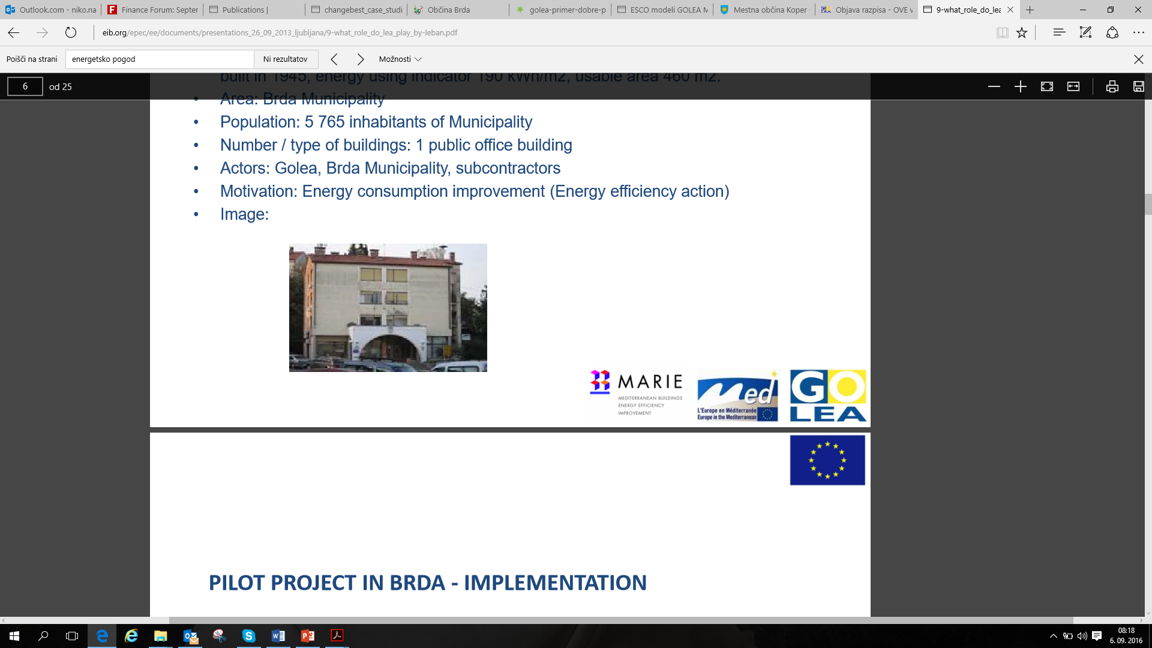
Experience in Slovenia – Renovation of a municipal building at Municipality Brda - MARIE project using the ESCO model GOLEA MARIE.
  Pilot characteristics: Energy wasteful public office building owned by municipality, built in 1945
  Energy use indicator 190 kWh/m2, usable area 460 m².
  Area: Brda Municipality
  Population: 5,765 inhabitants of Municipality
  Number / type of buildings: 1 public office building
  Actors: GOLEA, Brda Municipality, subcontractors
  Motivation: Energy consumption improvement (Energy efficiency action)

Slide 13
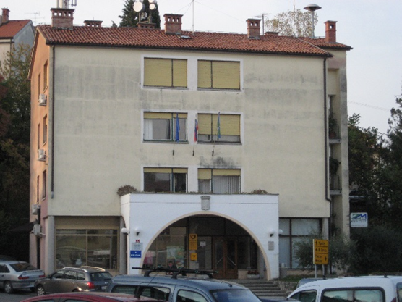
An example of the renovation of a municipal building at Municipality Brda - MARIE project using the ESCO model GOLEA MARIE.
  Energy audit, proposals to reduce energy costs
  Energy management
  Energy monitoring and targeting (M&T)
  Implement proposals to improve insulation (co-financing by project MARIE)
  Implement ESCO financing model

Slide 14
An example of the renovation of a municipal building at Municipality Brda – Energy Management System (EMS)
  Implementation of pilot energy management system CSRE
  Based on data from monthly energy bills.
  Energy supervisory system data integration (Municipality building Brda).
  Setting first energy performance indicators.
  Evaluation on energy efficiency.
  Encouraging first steps for improving energy efficiency, based on systematic energy efficiency evaluation.
  Setting strong base for long-term energy savings.

Slide 15
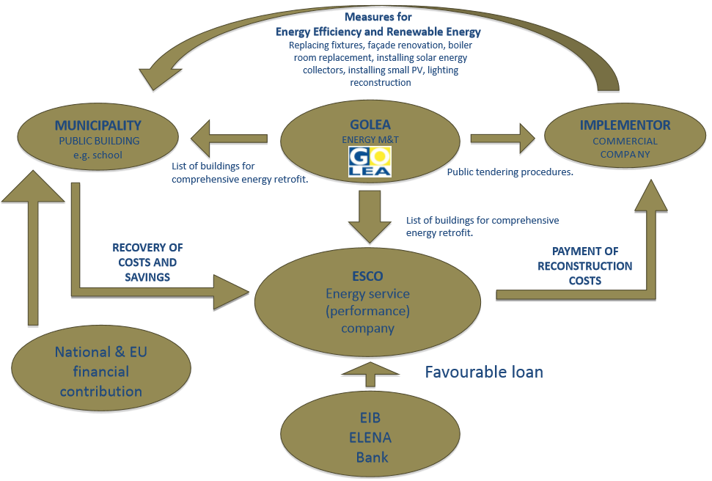
GOLEA-MARIE
MODEL

Slide 16
An example of the renovation of a municipal building at Municipality Brda
  The EU commission just approved technical assistance through EIB ELENA in the range of 2.25 million € for carrying out at least 45 million € renovation projects in the next 3 years in 23 cooperating municipalities
  The amount of co-financing for project preparation up to contract signature with an contractor (through PPP or PP) is 90% or 2,025,000 €, while 10% or 225,000 € will be provided by the municipalities themselves.
  The largest share of projects is focused on deep renovation of public buildings.
  Estimated investments carried out on 97 public buildings will amount to 41,740,661 €.
  In addition there is 7,318,651 € projected for carrying out investment in construction of district heating systems powered by RES, 5,527,736 € for renovation of public lighting systems, 2,457,300 € for supporting sustainable urban mobility and 1,835,000 € for improvement of public utility systems from an energy perspective (altogether about 59 million€)

Slide 17
Long-Term Strategy for mobilising Investments in the energy renovation of buildings (DSEPS) in Slovenia
  The intermediate targets set out in DSEPS up to 2030 are as follows:
  to reduce end-use energy consumption in buildings by 15% by 2020 and 30% by 2030 relative to 2005;
  to have at least two-thirds of energy in buildings produced from renewable energy sources;
  to reduce greenhouse gas emissions in buildings by 60 % by 2020 and at least 70 % by 2030 relative to 2005;
  to carry out energy renovation on at least 26 million m2 of building floor area, or 1.3–1.7 million m2 annually, with just over one third of this total renovated to nearly zero-energy building standard (AN sNES).
  The Strategy’s operational targets up to 2020 or 2030 are as follows:
  the renovation of 3% of public buildings owned or occupied by central government each year (between 15,000 and 25,000 m²);
  the renovation of 1.8 million m² of the floor area of buildings in the wider public sector between 2014 and 2023 (OP EKP);
  an improvement in the ratio between public funds invested and investment incentives in the public sector to 1: 3 (OP TGP 2020);
  the implementation of five energy renovation demonstration projects for different building types (OP EKP).

Slide 18
National tender for co-financing energy renovation
  Investments in building renovation of approx. EUR 6.7 billion will be required to achieve these targets in the period leading up to 2030: three-quarters in the housing sector, 10 % in the public sector and 15% in the private service sector.
  This means annual investments of between EUR 350 and 450 million: approx. EUR 300 million in the housing sector and EUR 100 million in the service sector (EUR 40 million in the public sector and EUR 60 million in the private sector)
  National tender for co-financing of energy renovation
  Co-financing rate : Up to 40% of investment
  Financing: European Cohesion fund 85%, National participation 15 %
  Eligible measures : All measures related to improving energy efficiency and the share of renewable energy in buildings primary energy on existing buildings
  First round will be initiated in December, for which projects will have to be realized by the end of 2018.

Slide 19
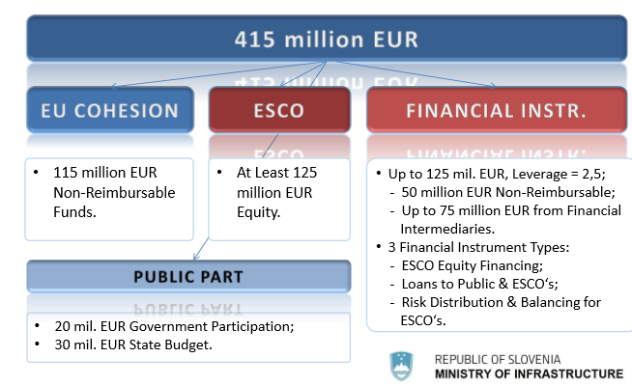
National tender for energy renovation

Slide 20
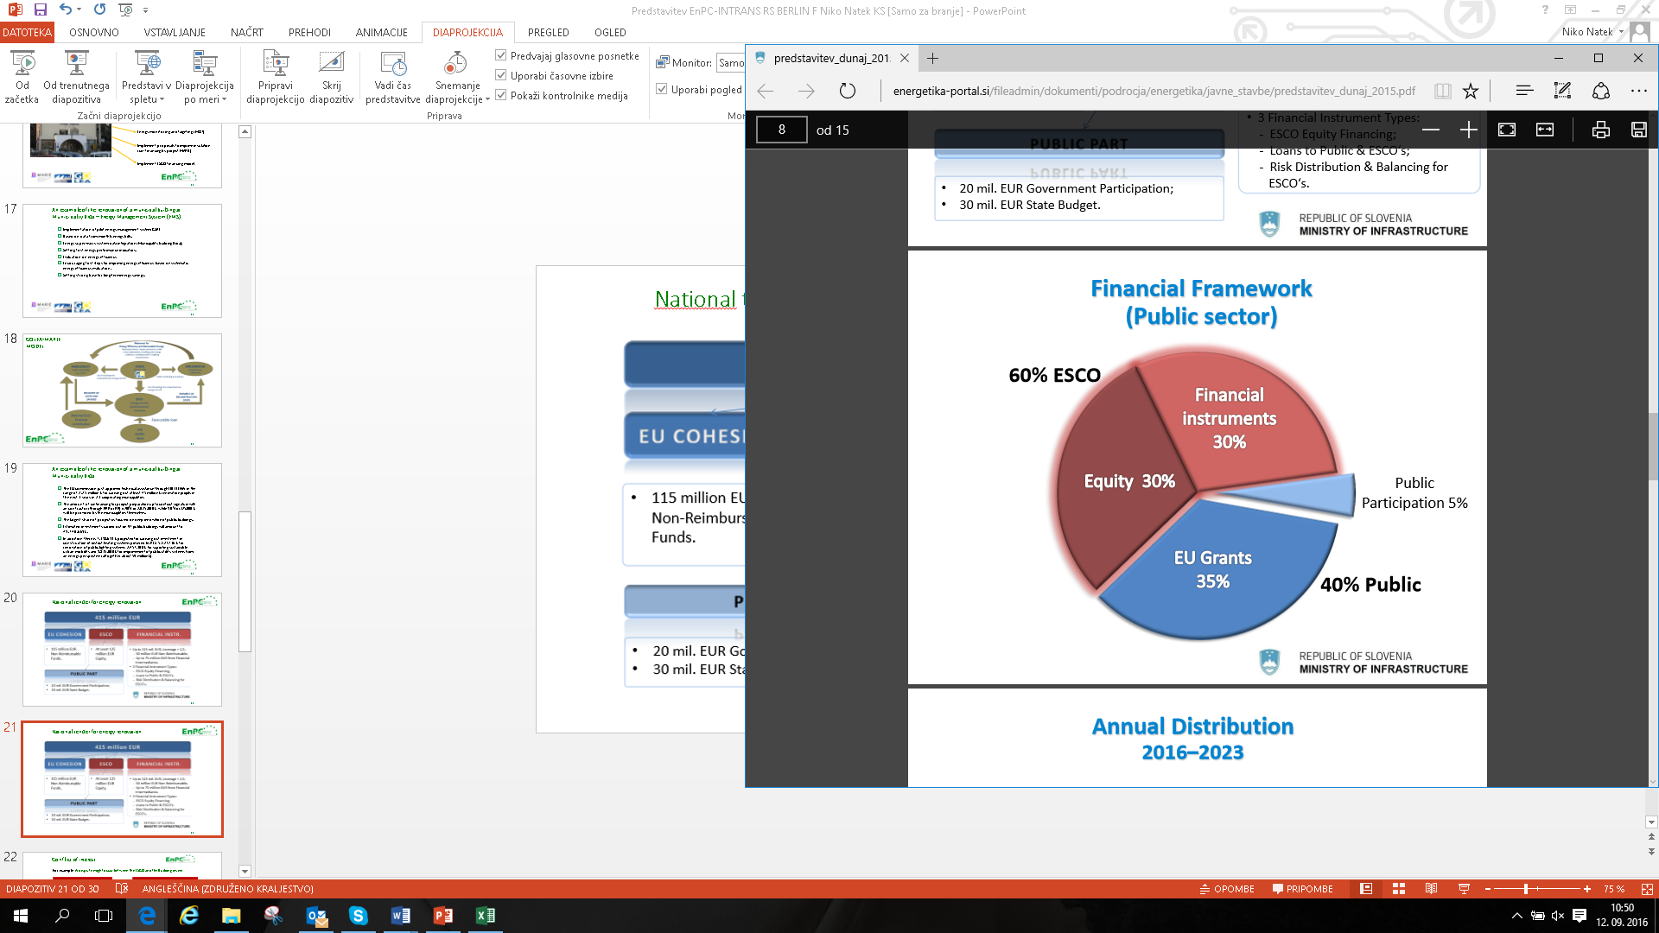
National tender for energy renovation - Financing

Slide 21
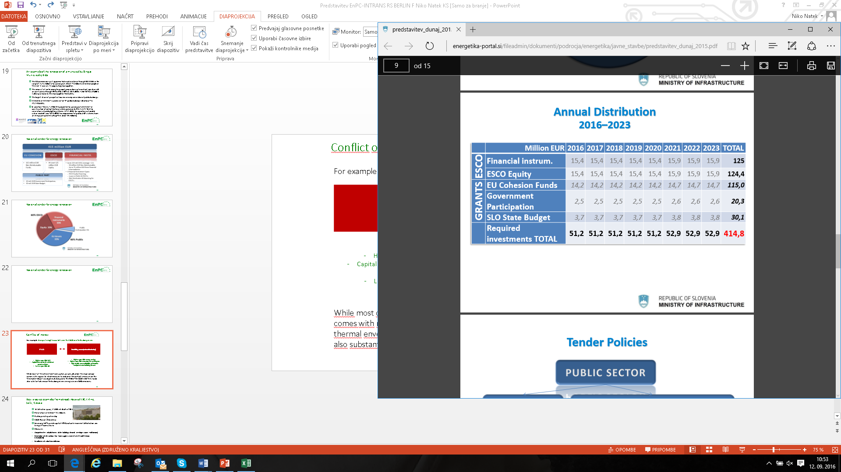
National tender for energy renovation – Financing

Slide 22
EPC plus in the Municipality of Celje 2016 – 2023
  Preparation of investment documentation for energy renovation of public buildings
  Initial investment was supposed to include deep energy renovation of 25 buildings, including primary schools and kindergartens, sports halls, administrative buildings, etc.
  Total investment of 8,542,534 EUR, 5,686,946 EUR (with VAT) to be provided by the ESCO.
  Municipality would need to provide 2.855.588 EUR (40% co-financing from the state, 60% by the municipality) and an additional of 81,468 EUR non eligible expenses.
Discount rate | 5 %
Assumed rate of price increase | 1.20 %
Payback period | 33 years
NPV after 15 years | -2,260,299 €
IRR after 15 years | -1.51 %
Payback period at 7 % discount rate | More than 35 years

Slide 23
EPC plus in the Municipality of Celje 2016 – 2023
  The decision was made to divide the buildings into primary (set A) and secondary (set B) investments
  11 buildings with non-justifiable economic indicators were excluded from set A
  Total investment of 3,017,009 EUR with 1,746,335 € or 58% (with VAT) to be provided by the ESCO.
  Municipality would need to provide 1,270,674 (up to 40% or 962,472 € co-financing from the state, 60% by the municipality).
Discount rate | 5%
Assumed rate of price increase | 1.20%
Payback period | 13 years
NPV after 15 years | 114,680.02 €
IRR after 15 years | 5.93%
Payback period at 7 % discount rate | 16 years

Slide 24
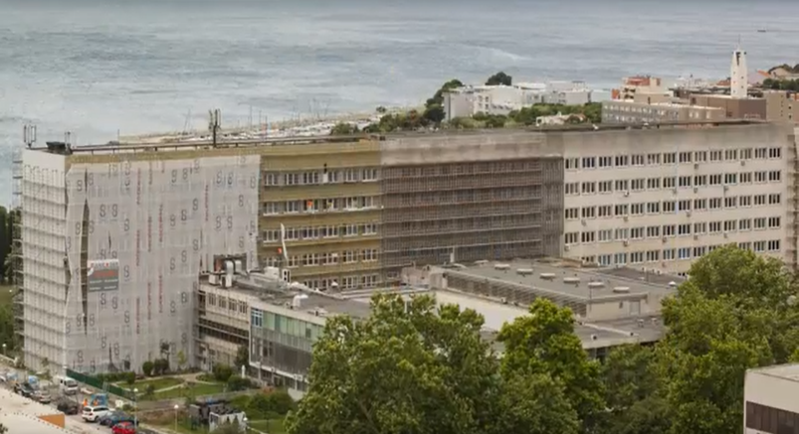
Best practice examples from abroad: Hospital KBC Križine, Split, Croatia
    Total heated space; 37,000 m² (Built in 1965)
    Renovation investment: 15 million €
    Public private partnership
    ESCO: Rudan Žminj Istria
    Financing: 60% private capital, 40% Croatian Environmental Protection and Energy Efficiency Fund
    Measures:
    Comprehensive refurbishment of the buildings thermal envelope (Stone wall facade)
    Renovation of the sanitary hot water supply system (4 x MHI 30kW Q-ton Mitsubishi)
    Instalment of solar heat collectors

Slide 25
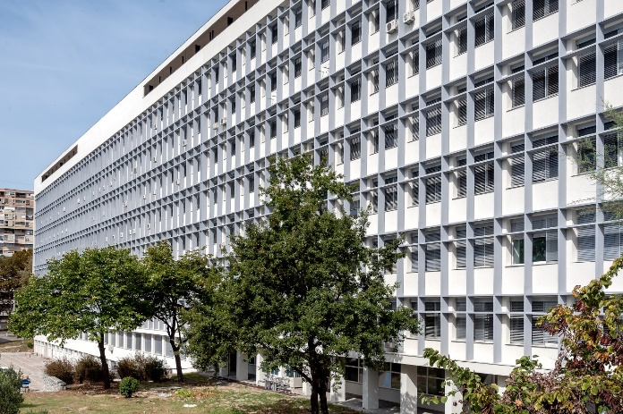
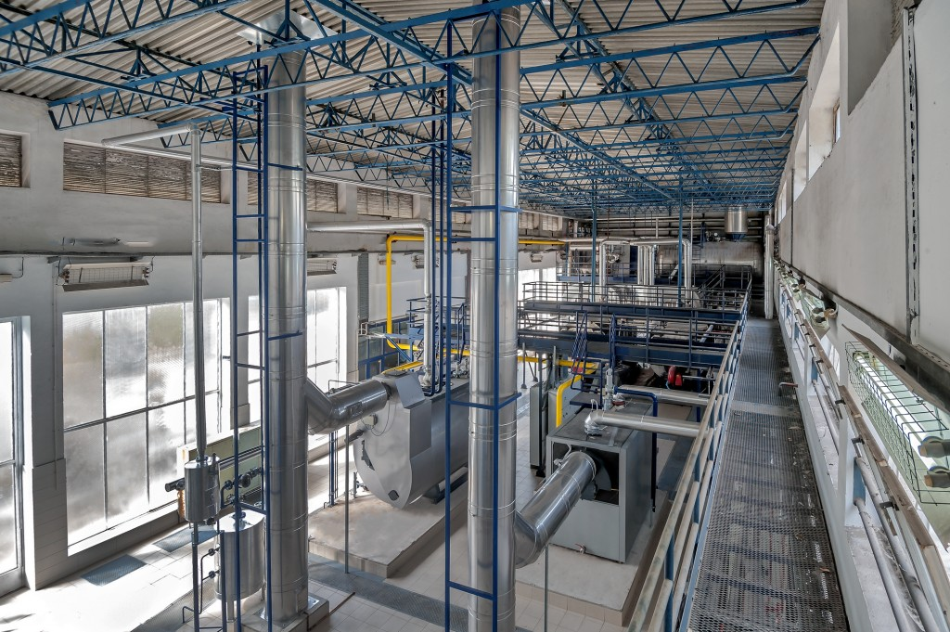
Best practice examples from abroad: Hospital KBC Križine, Split, Croatia
    Payback period of the investment through savings will be 14 years
    Energy cost before renovation: ca. 1.3 million € annually
    Energy cost after renovation: less than 600,000€ annually
    Achieved savings:
    Cumulative 55% energy savings
    74% water savings

Slide 26
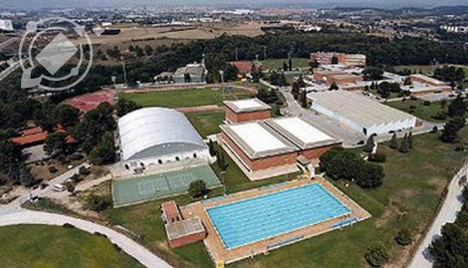
Best practice examples from abroad: Sport complex in Sant Cugat del Vallès, Spain
    Contract format: Energy services with guaranteed savings.
    ESCO in charge: COMSA EMTE
    Period of intervention: 2013 –2023
    Contract duration: 10 years
    Guaranteed savings: 39%
    Value of the contract: 3.184.347 € (1,2 M € for EE measures)

Slide 27
Best practice examples from abroad: Sport complex in Sant Cugat del Vallès, Spain
    Reference energy costs before renovation: 735.000 €/year
    Reference electricity consumption: 3.467.358 kWh/year
    Reference thermal consumption: 5.292.378 kWh/year
    Implemented measures:
    Renovation of the cooling system
    Replacement of direct expansion equipment for air conditioning
    Replacement of lighting equipment
    Replacement of diesel boilers with natural gas boilers
    Installation of a pool dehumidifier
    Improvement of the pool pumping systems
    Improved insulation of the pool and pipes
    Implementation of a Building Management System
    Solar thermal system with 96 vacumm solar thermal panels

Slide 28
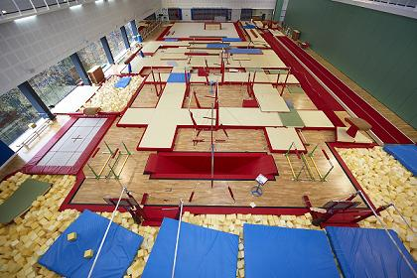
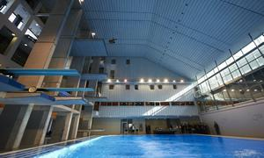
Best practice examples from abroad: Sport complex in Sant Cugat del Vallès, Spain
    Electric savings: 263.675 kWh/year
    Thermal savings: 3.063.308 kWh/year
    Energy savings: 39%
    CO2 savings 1.036 tn CO2/year
    Cost savings: 296.000 €/year (93.000 €/year clean savings for CAR)

Slide 29
THANK YOU FOR YOU ATTENTION!
www.encp-intrans.eu
Projekt prejema sredstva s strani
nemškega zveznega ministrstva za ekonomsko sodelovanje in razvoj
Projekt je financiran s strani okvirnega programa Obzorje 2020 za Raziskave in Razvoj Evropske Unije na podlagi dogovora o podpori št. 649693

